Slide 1

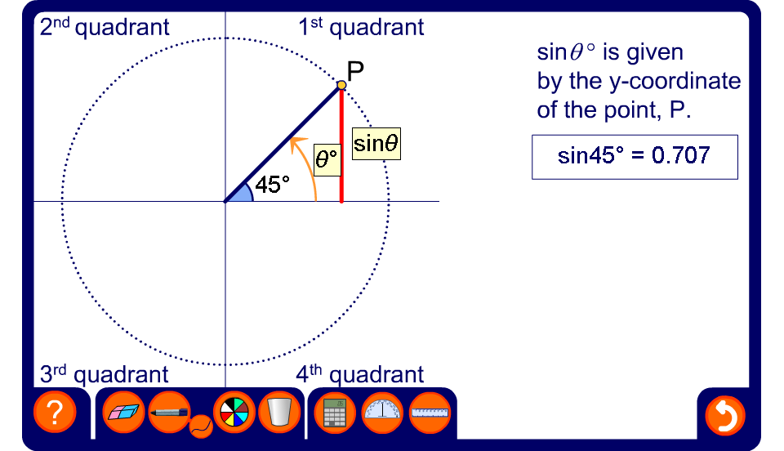


The sine of any angle
Notes:
Explain that we can find the sine of any angle by considering the movement of the point P which is fixed at 1 unit from the origin on a coordinate grid. Sin θ is given by the y-coordinate of the point P. This is show by the length of the bold orange line.
Explain that moving the point P in an anticlockwise direction increases the angle between OP and the x-axis. In maths, an anti-clockwise rotation is a positive rotation.
Slowly, drag the point P through 360°, starting at 0° and ending at 360°. Observe the length of the line representing the y-coordinate of the point P as it is rotated. Point out that when the line is in the first and the second quadrant, that is, when θ is between 0° and 180°, it is above the x-axis and therefore positive. In other words, the sin of angles between 0° and 180°, is positive. When the line representing sin θ is in the third and the fourth quadrant, that is, when θ is between 180° and 360°, it is below the x-axis and therefore negative. In other words, the sine of angles between 180° and 360° is negative.
In this activity, P can be moved through any angle between –360° and 720°. Demonstrate the sine of these angles if required. Explain that P can be moved through any positive or negative angle in this way.
Focusing on angles between 0° and 180° (that is, angles in the first and second quadrants) demonstrate the relationships between pairs of angles that have the same sine. For example, show that sin 32° = sin 148°. Conclude that sin θ = sin (180° – θ).
Focus next on angles between 180° and 270° (that is, angles in the third quadrant) . By looking at the sine of the associated acute angle show that sin θ = – sin (θ – 180°).
In the fourth quadrant, examine angles between 270° and 360° and between 0° and –90°. Conclude that sin θ = – sin (360° – θ) for angles between 270° and 360° and sin –θ = – sin θ.

